Slide 1
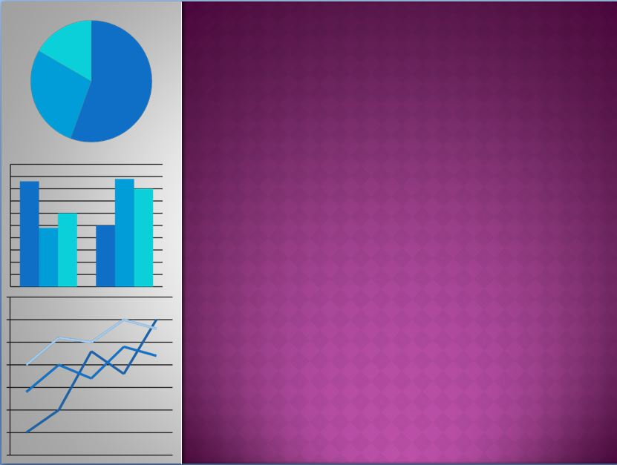
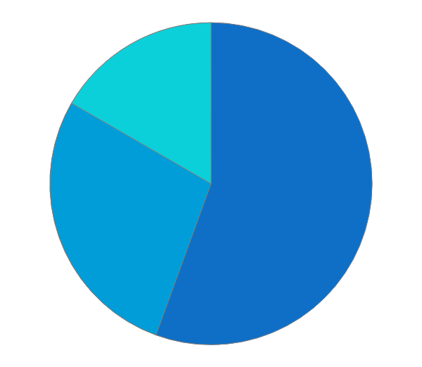
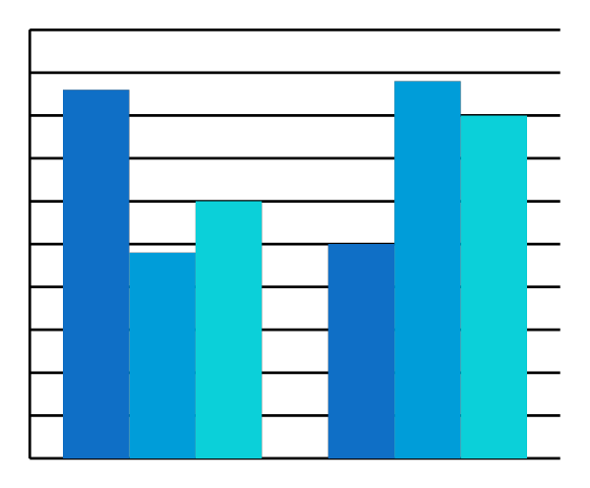
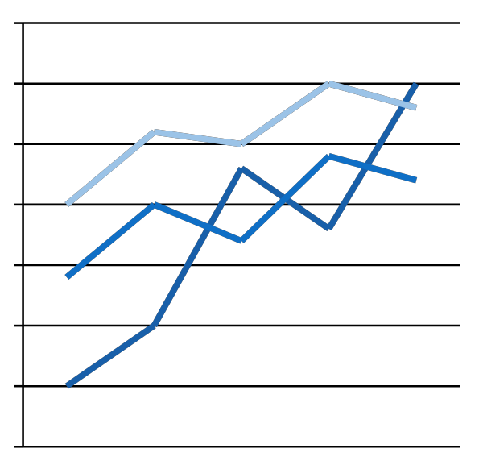
IOT Based Biometric Attendance For Data Visualization
GROUP NO.12
Group Members Student ID
DINESH DESHMUKH 16204015
NILESH MOHITE 16204030
AKASH BAMNE 16204020
YASH BHOIR 15104031
PROJECT GUIDE AND CO-GUIDE
PROF.GANESH GOURSHETE

Slide 2

ABSTRACT
In recent past, the number of applications based on biometric and have been successfully applied to different areas as diverse as education, government offices industry
the objective of this system is to design and develop a student attendance system used in universities for students
Made to solve manual class attendance monitoring problem in developing countries using iot and biometric technology
A lecturer has to pass the attendance system to mark attendance of students.
Internet of things (iot) is used to monitor and manipulate the data stored on server
This system not only helps teacher to take attendance is useful for displaying data and information in the form of graphical charts, figures, and bars.
It helps to generate visual reporting for the performance or general statistics of student as per students attendance

Slide 3
INTRODUCTION
The old method for taking attendance is manual work this method takes a lot of time and there are chances that the attendance is not marked properly.
There is a lots of chances of making mistakes in taking daily attendance of the students
all these limitations in current system it is necessary to design a system for managing automatic attendance without any mistakes.
The proposed system is used for taking the daily attendance of the students by using fingerprint of the students and managing the attendance in suitable environments like colleges
The faculty activates the system for marking attendance and provides it to the students when enter the classroom attendance of the students will be marked in the database after the fingerprint detection

Slide 4
LITERATURE REVIEW
Sr No. | Author | Methodology | Merits | Limitation
1. | Lianjun Chen & Hongbo Zhou | Procedures of dynamic and interactive data visualization from several angles: data processing and data visualization | Key technologies are svg and D3 Svg supports image objects, vector graphics , raster graphics and text. D3 combines data from database with html,svg,css | Svg:the file size is growing very fast, if the object consists of a large number of small elements;it’s impossible to read a part of the graphic object, only the entire object and it slows you down.
2. | M.A. Meor Said, M.H. Misran , M.A. Othman, M.M. Ismail, H.A. Sulaiman, A. Salleh, N. Yusop | Displays Attendace on lecturer computer with more attractive graphics and having students complete details using the Fingerprint Reader. | It will used student fingerprint and students do not need to bring any device.This system will integrate with Fingerprint Reader that available in the market. | Systems are not 100% accurate.Require integration and/or additional hardware Cannot be reset once compromised
3. | Benfano Soewito, Ford Lumban Gaol, Echo Simanjuntak &Fergyanto E. Gunawan | Attendance system based on GPS using a smartphone ﬁnger print scanner to mark attendance | Its use is practical and simple Attendance data collection more accurate. Because the media used to record employee absences is their fingerprints | Attendance system using this fingerprint can not eliminate the problem of long queues at entry work and also at the time out of work.

Slide 5
PROBLEM STATEMENT
Manual method have a lots of limitations such as every time a lecture, section or laboratory starts the lecturer or teaching assistant delays the lecture to record students’ attendance.
This is a lengthy process and takes lot of time and effort, especially if it is a lecture with huge number of students.
Moreover the attendance sheet is subjected to damage and loss while being passed on between different students of teaching staff.
The lecturers tend to call a couple of students name at random which is not fair student evaluation process either.
This process could be easy and effective with a small number of students but on the other hand dealing with the records of a large number of students often leads to human error.
So to overcome all these limitations of the current system we are designing a system whose main aim is to mark the students attendance automatically and also with in less time and errors.

Slide 6
PROJECT SCOPE
In future work the same project can be utilized for several security applications where authentication is needed to access the privileges of the respective system.
Providing the visualization of attendance after the attendance gets marked successfully by the student on the system itself
We can also use android application on parent side in future so that timely update of their child in school can be send to them on their android phones using iot.
We can also trace a particular student in an organization quickly with the help of this system.
Application of this system is that it is capable of marking the presence of employees at any workplace and this attendance will be useful for calculating their monthly payment.

Slide 7
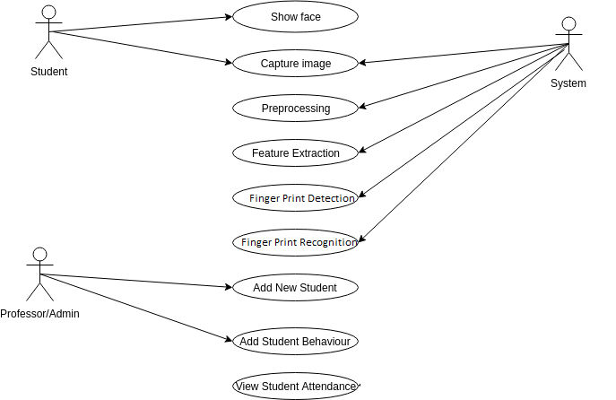
USECASE DIAGRAM

Slide 8
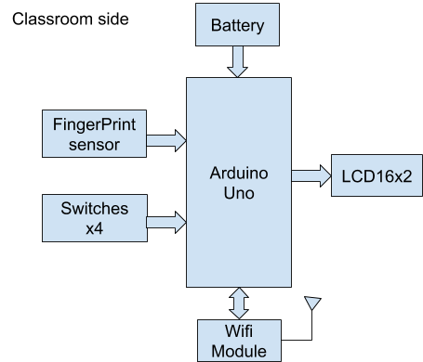
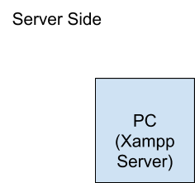
ARCHITECTURE

Slide 9
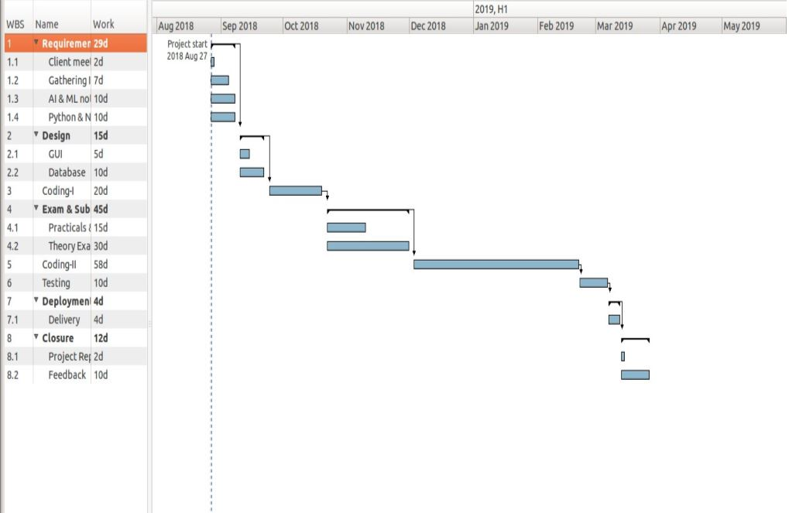
PROJECT FUTURE PLAN

Slide 10
SUMMARY
• As per our planning the project requirement and analysis phase is completed.
• In analysis step we have gone through some topic related IEEE papers and analysis of data visualization techniques.
• we have gone through various data visualization tools.
• openrefine,pentaho and microsftBI.

Slide 11
REFERENCES
[1] Zhang chen,Yang yu,Gu lize.An Interactive Data Visualization Model Based on D3 and Raphael[EB/OL].Beijing:Sciencepaper Online[2013-1004].http://www.paper.edu.cn/releasepaper/content/201310-40.
[2] Zhao cong. Research on Application of Visualization D3.js Library[J].2015(2):107-109.
[3] Piyush Devika, Ajit Krishnamoorthy, Aditya Bhanage,Mohit Singh Chauhan,“IoT Based Biometric Attendance System”International Journal of Advanced Research in Computer and Communication Engineering M S Ramaiah Institute of Technology, Bangalore Special Issue 2, October 2016
[4]. Amit Kumar, P.K. Varma, Srinivas Perala, P. R. Chadha, “Automatic Attendance System By Visual Programming Language LabVIEW,” in IEEE International Conference On Power Electronics, Intelligent Control and Energy System 2016

Slide 12
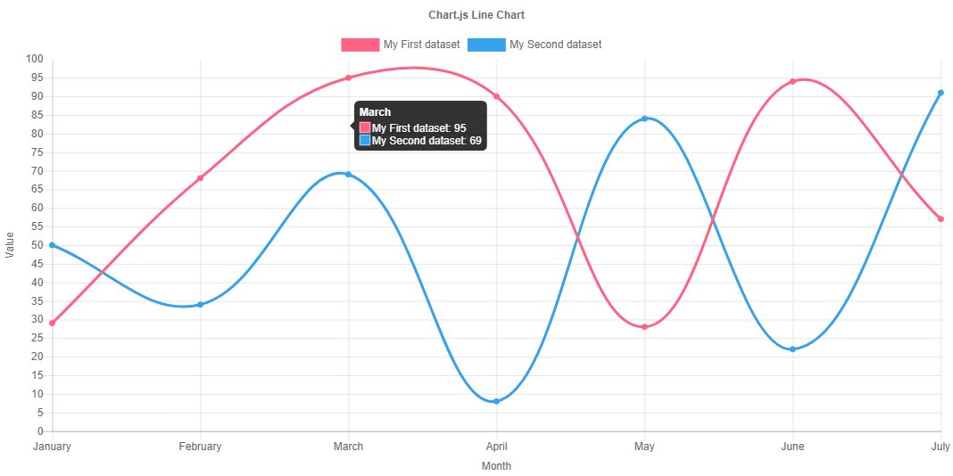
Graphs in chart.js

Slide 13
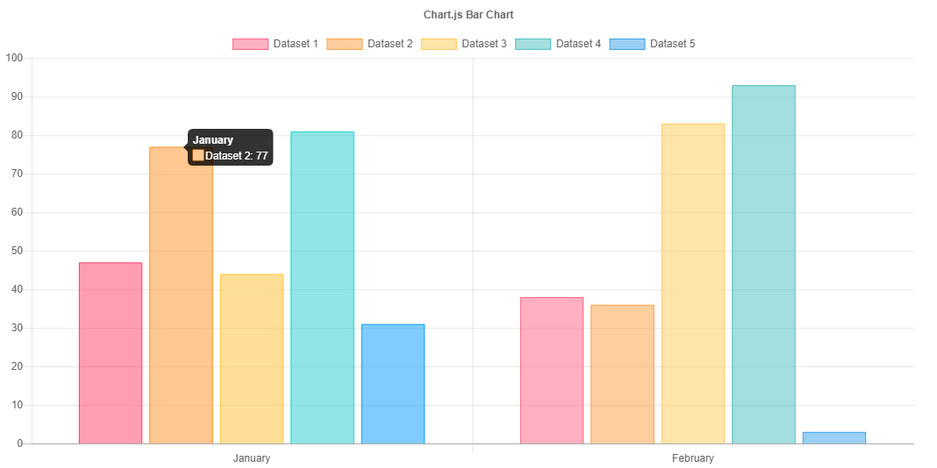

Slide 14
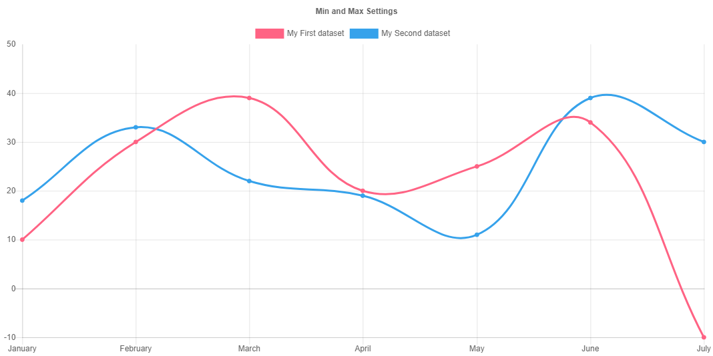

Slide 15
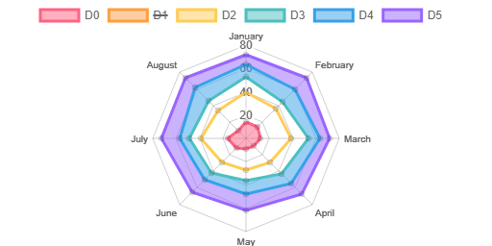
Above graphs provide the view of student’s overall ward attendance using tool called
chartjs
Using essential data of a particular student the defaulter list will be generated
automatically and updated as per requirement

